Slide 1

TESTING MYNTRA
E-COMMERCE APPLICATION USING APPIUM
Thota ashwath
192011375
CSA3732-SOFTWARE TESTING for mobile applications

Slide 2
OBJECTIVE
E-commerce(Myntra) testing helps in evaluating and accessing the features and functionalities so that it works as intended with accurate operational functionality.

Slide 3
ABSTRACT
The purpose of the project is to test the e-commerce website like myntra.
The e-commerce business is increasing at a rapid pace especially since covid. So it is very important to test e-commerce websites and applications such as myntra.
The process of testing various website or application elements such as design, specifications, functionalities, pages, and features to check their sanity and ensure they're not harming the performance of the site in any manner possible.

Slide 4
PROPOSED SYSTEM
>>Automation of an application can be done using e-commerce testing tools such as appium server and appium inspector.
>>Testers can automate almost all functional tests using appium.
>>Below are the test cases for the online shopping system(myntra)
Login/signup
Search for product(clothes, jewellery and shoes and cosmetics)
Sorting
Filtering
Product description page
Wishlist
Shopping cart
Checkout
Payment gateway
Order confirmation

Slide 5
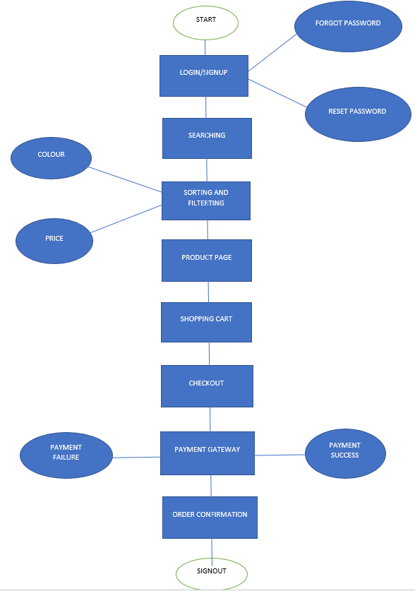
FLOW CHART

Slide 6
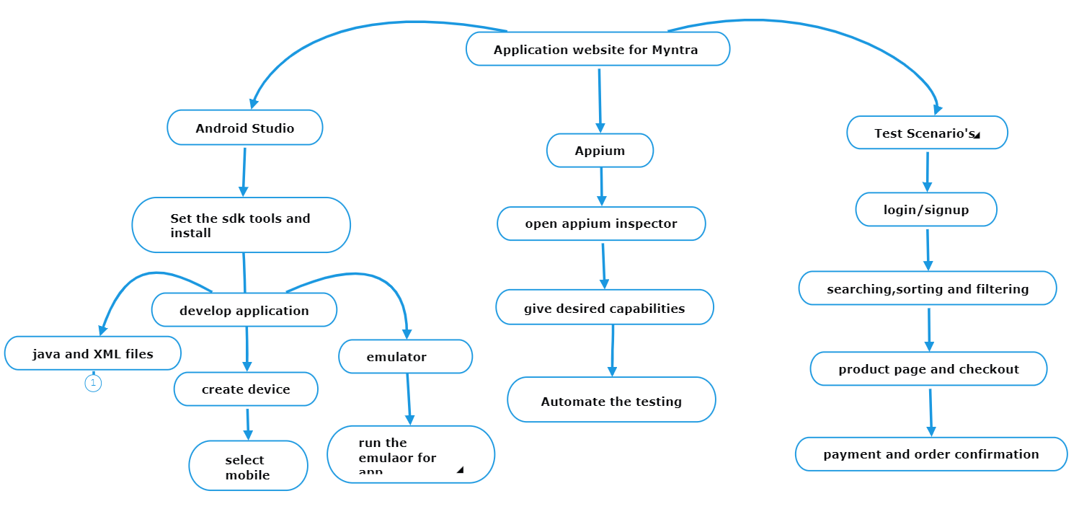
CONCEPT MAP

Slide 7
TEST CASES
Login/signup
Search for product (clothes,jewellery and shoes and cosmetics)
Sorting
Filtering
Product description page
Wishlist
Shopping cart
Checkout
Payment gateway
Order confirmation

Slide 8
APP TOOLS AND INSTALLATION
Android studio
Appium inspector
Appium server

Slide 9




Slide 10
INSTALLATION
Download android studio
Install SDK in android studio
Download emulator in android studio
Download appium inspector

Slide 11
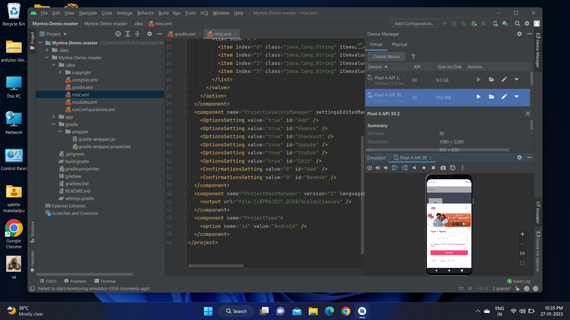
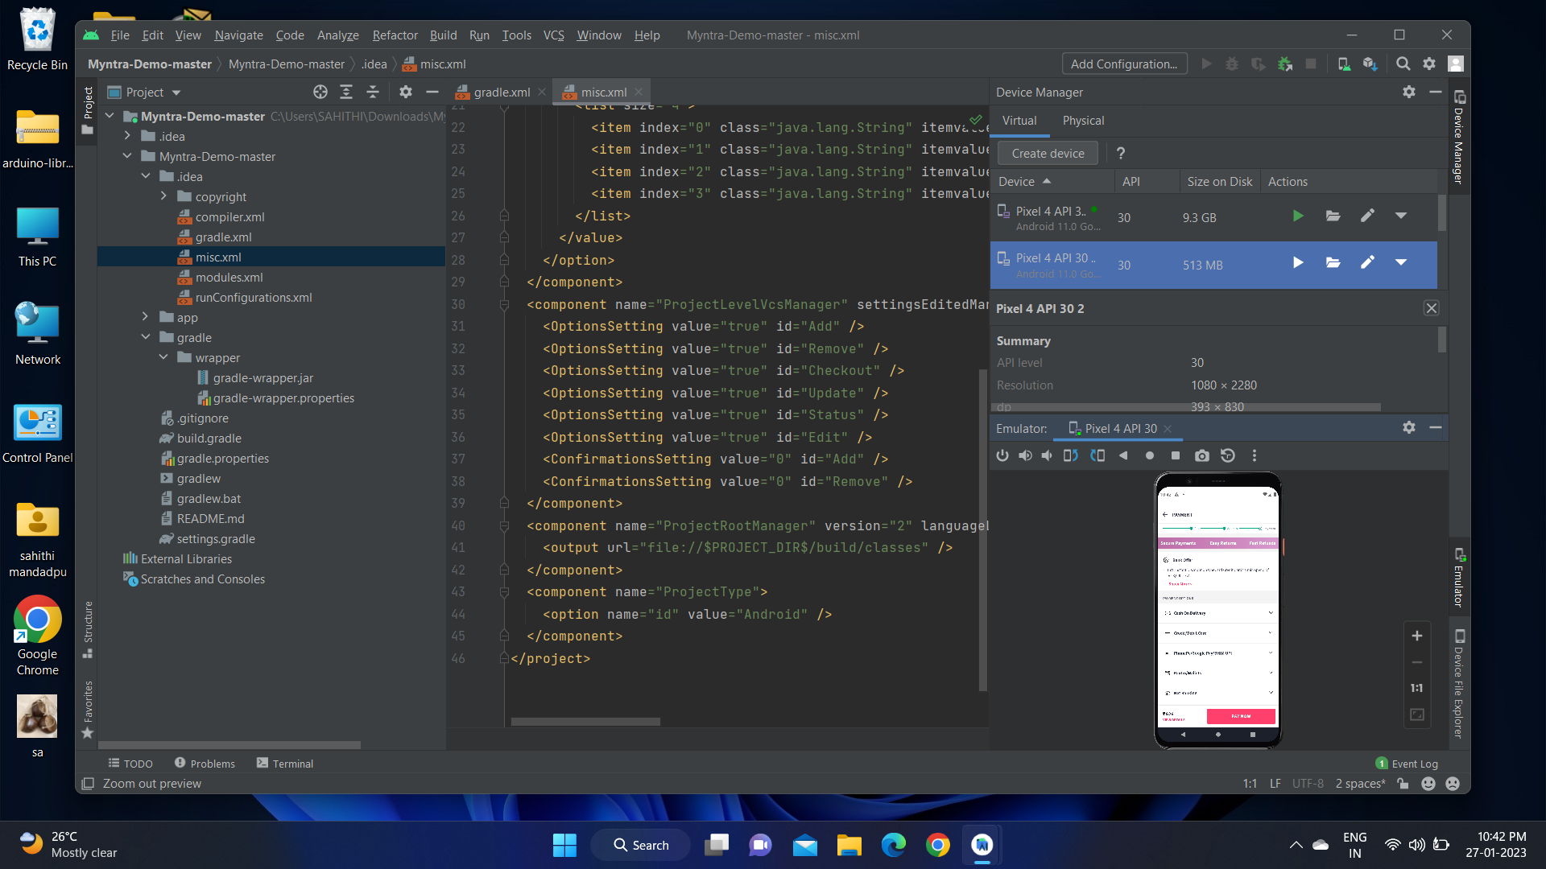
IMPLEMENTATION

Slide 12
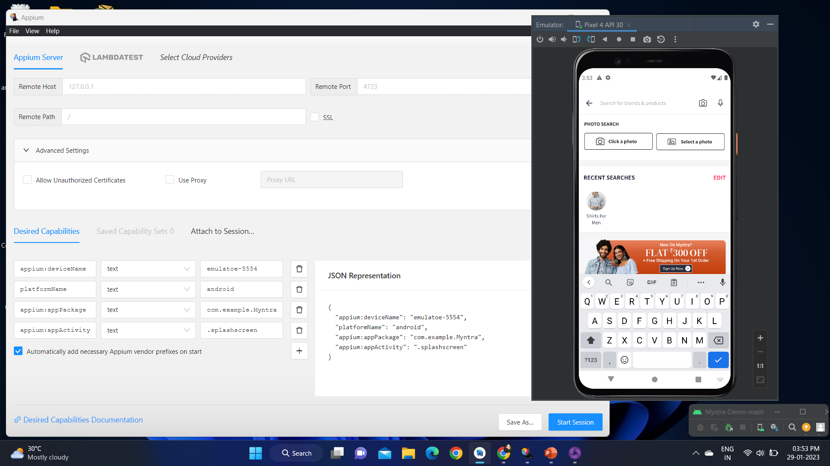
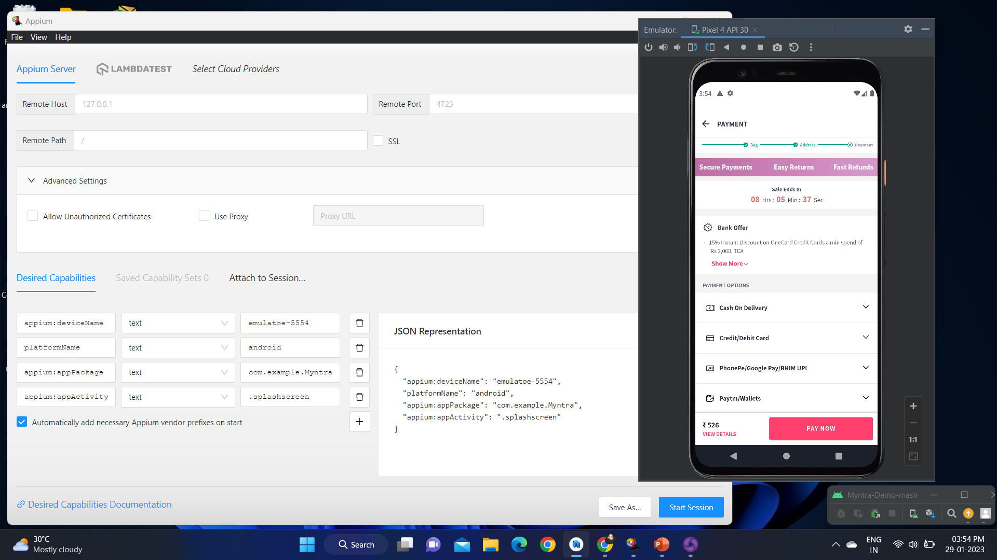

Slide 13
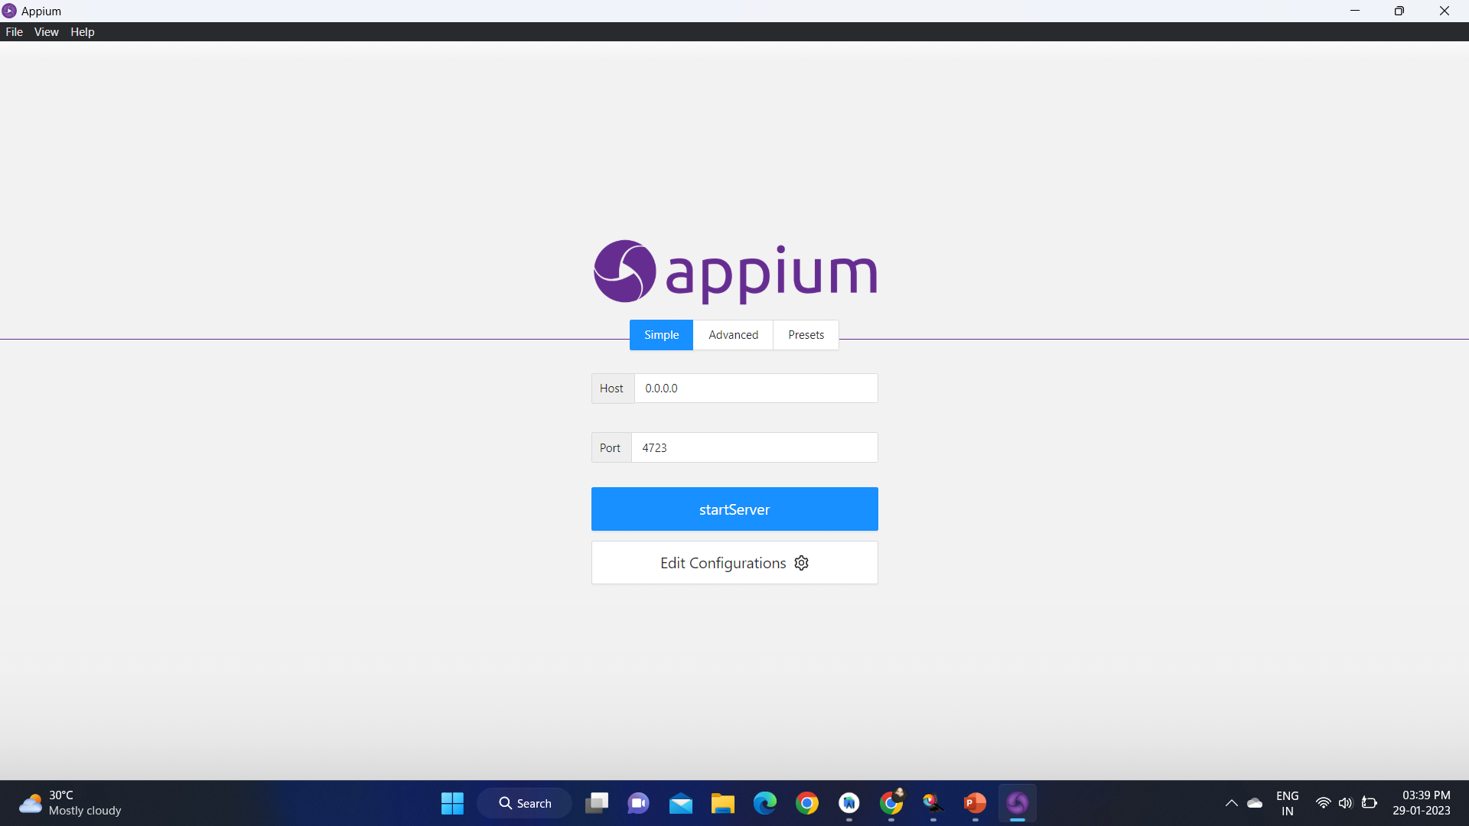
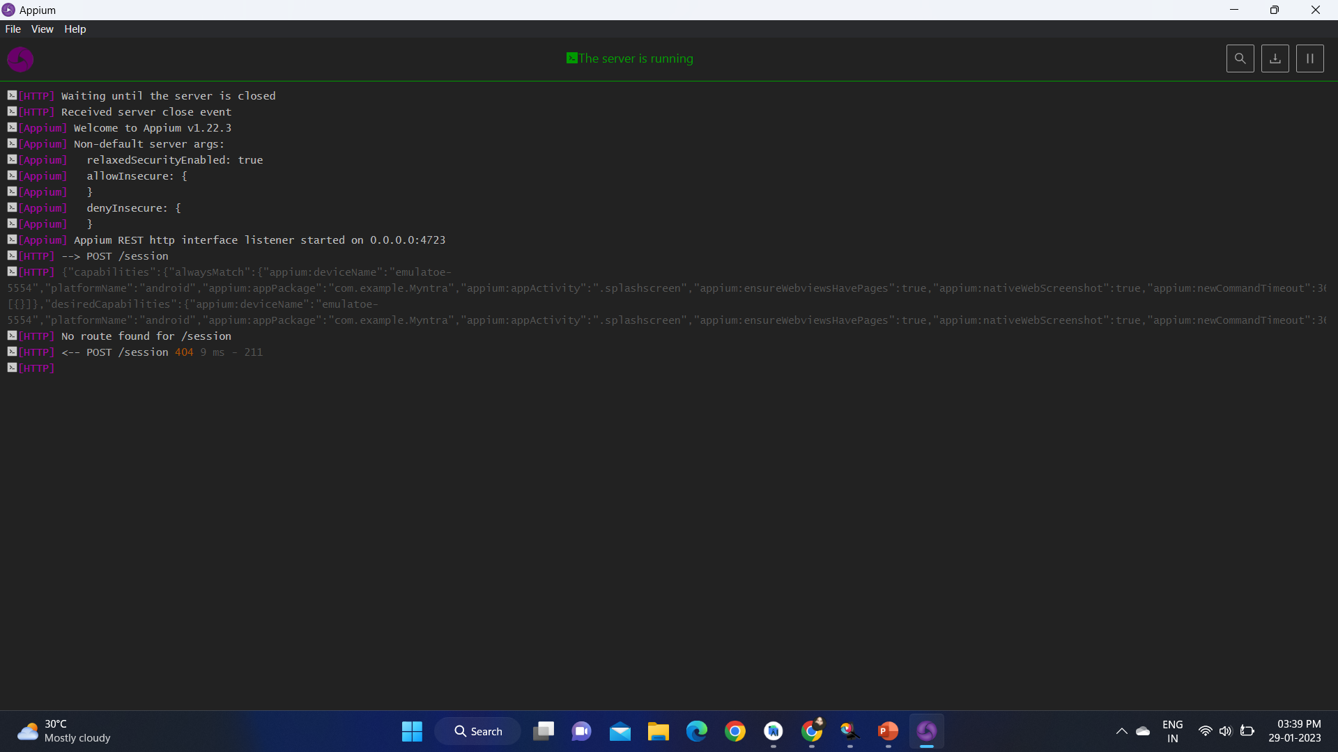

Slide 14
TESTCASE OUTCOMES
TESTCASES | POSITIVE/NEGATIVE
Verify if a user will be able to login with valid username and valid password. | POSITIVE
Verify if a user cannot login with a valid username and an invalid password. | NEGATIVE
Verify that on searching, all the products satisfying the search criteria are visible on the search result page. | POSITIVE
Verify if User search for product and it doesnot show the product. | NEGATIVE
Verify that filtering and sorting works correctly on the search result page. | POSITIVE
Verify that filtering and sorting doesnot works correctly on the search result page. | NEGATIVE
Verify that on the product page, the user can select the desired attribute of the product e.g. size, color, etc. | POSITIVE
Verify that the user cannot add to the cart one or more products. | NEGATIVE
Verify that the different prepaid methods of payments are working fine. | POSITIVE

Slide 15
CONCLUSION
The e-commerce application i.e Myntra has been developed using android studio.
And the testcases of this application have been tested successfully using Appium server and Appium inspection.
The testing of this website has the positive and negative test outcomes to understand and improve the application functionalities effectively.

